Slide 1
Environmental Data Acquisition and Processing
Water Resource Monitoring
Jason N Kabi
Centre for Data Science and Artificial Intelligence (DSAIL)
Dedan Kimathi University of Technology

Slide 2
Introduction
Work shop Brake down
Introduction water resource monitoring
What water parameters are being monitored?
How are the parameters monitored?
Hardware development
Data acquisition
Data analysis and presentation
Incorporation of other datasets
Water resource monitoring

Slide 3
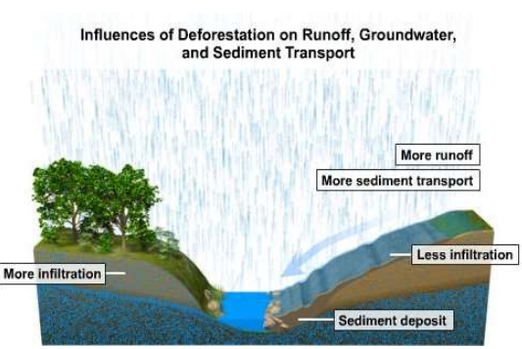
Introduction
Goal: River catchment analysis using water-level data by leveraging IoT and machine learning
Dataset
Takeaways
Water level data can be used to “diagnose” a river catchment by watching the trends over some time.
Question: How long does a spike in water level take to occur after a spike in rain.

Slide 4
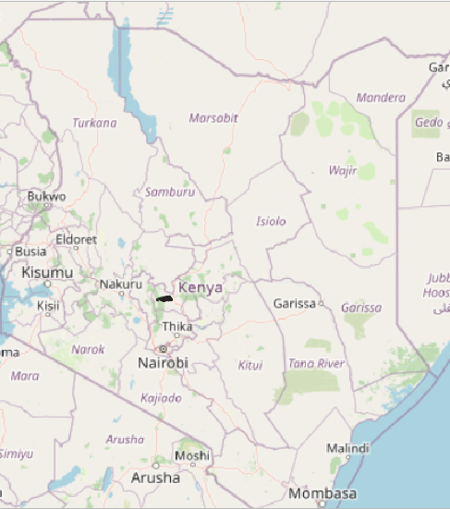
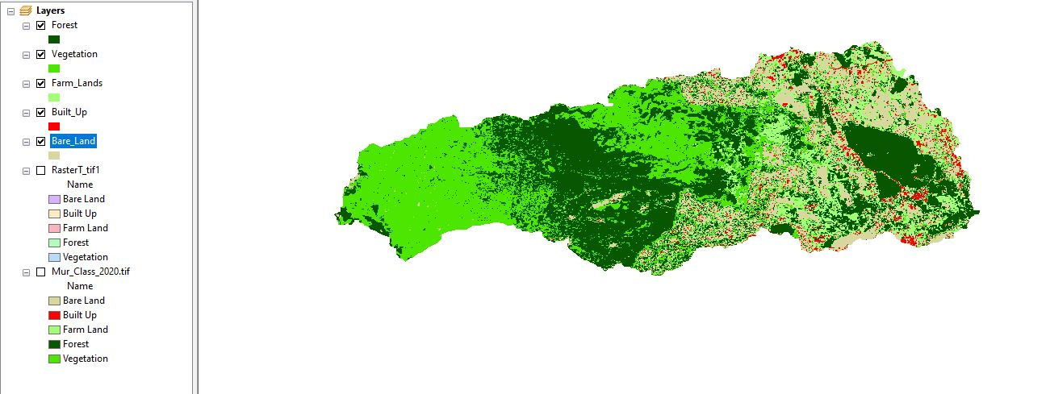
catchment under study

Slide 5
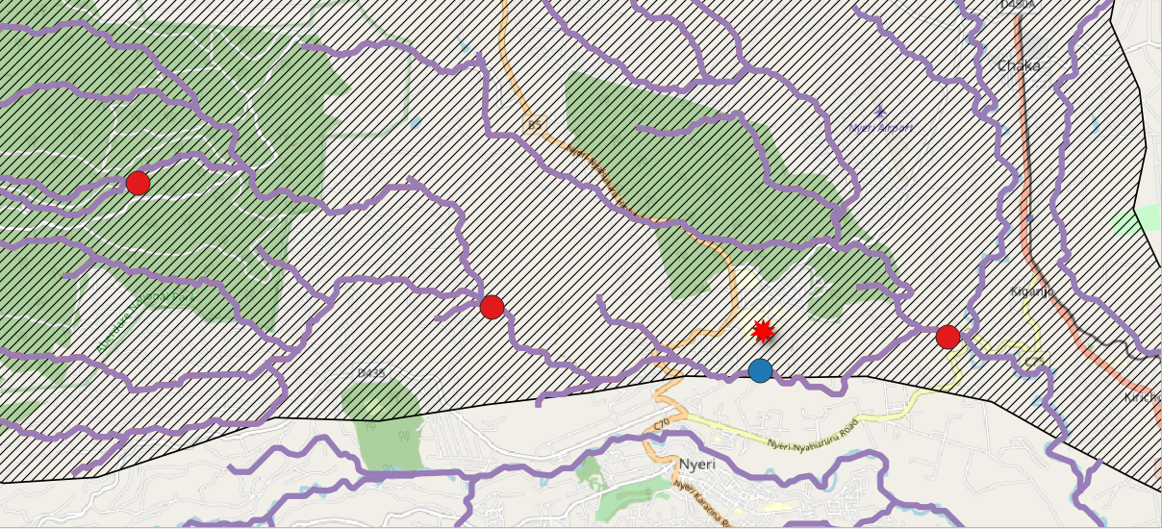
Deployment location (catchment under study)

Slide 6
Hardware development
Hardware development Brakedown
Setting up the LoRa IoT Network
LoRa Network analysis.
Hardware setup and schematic
Deploying the water-level prototypes
Water level resource monitoring

Slide 7
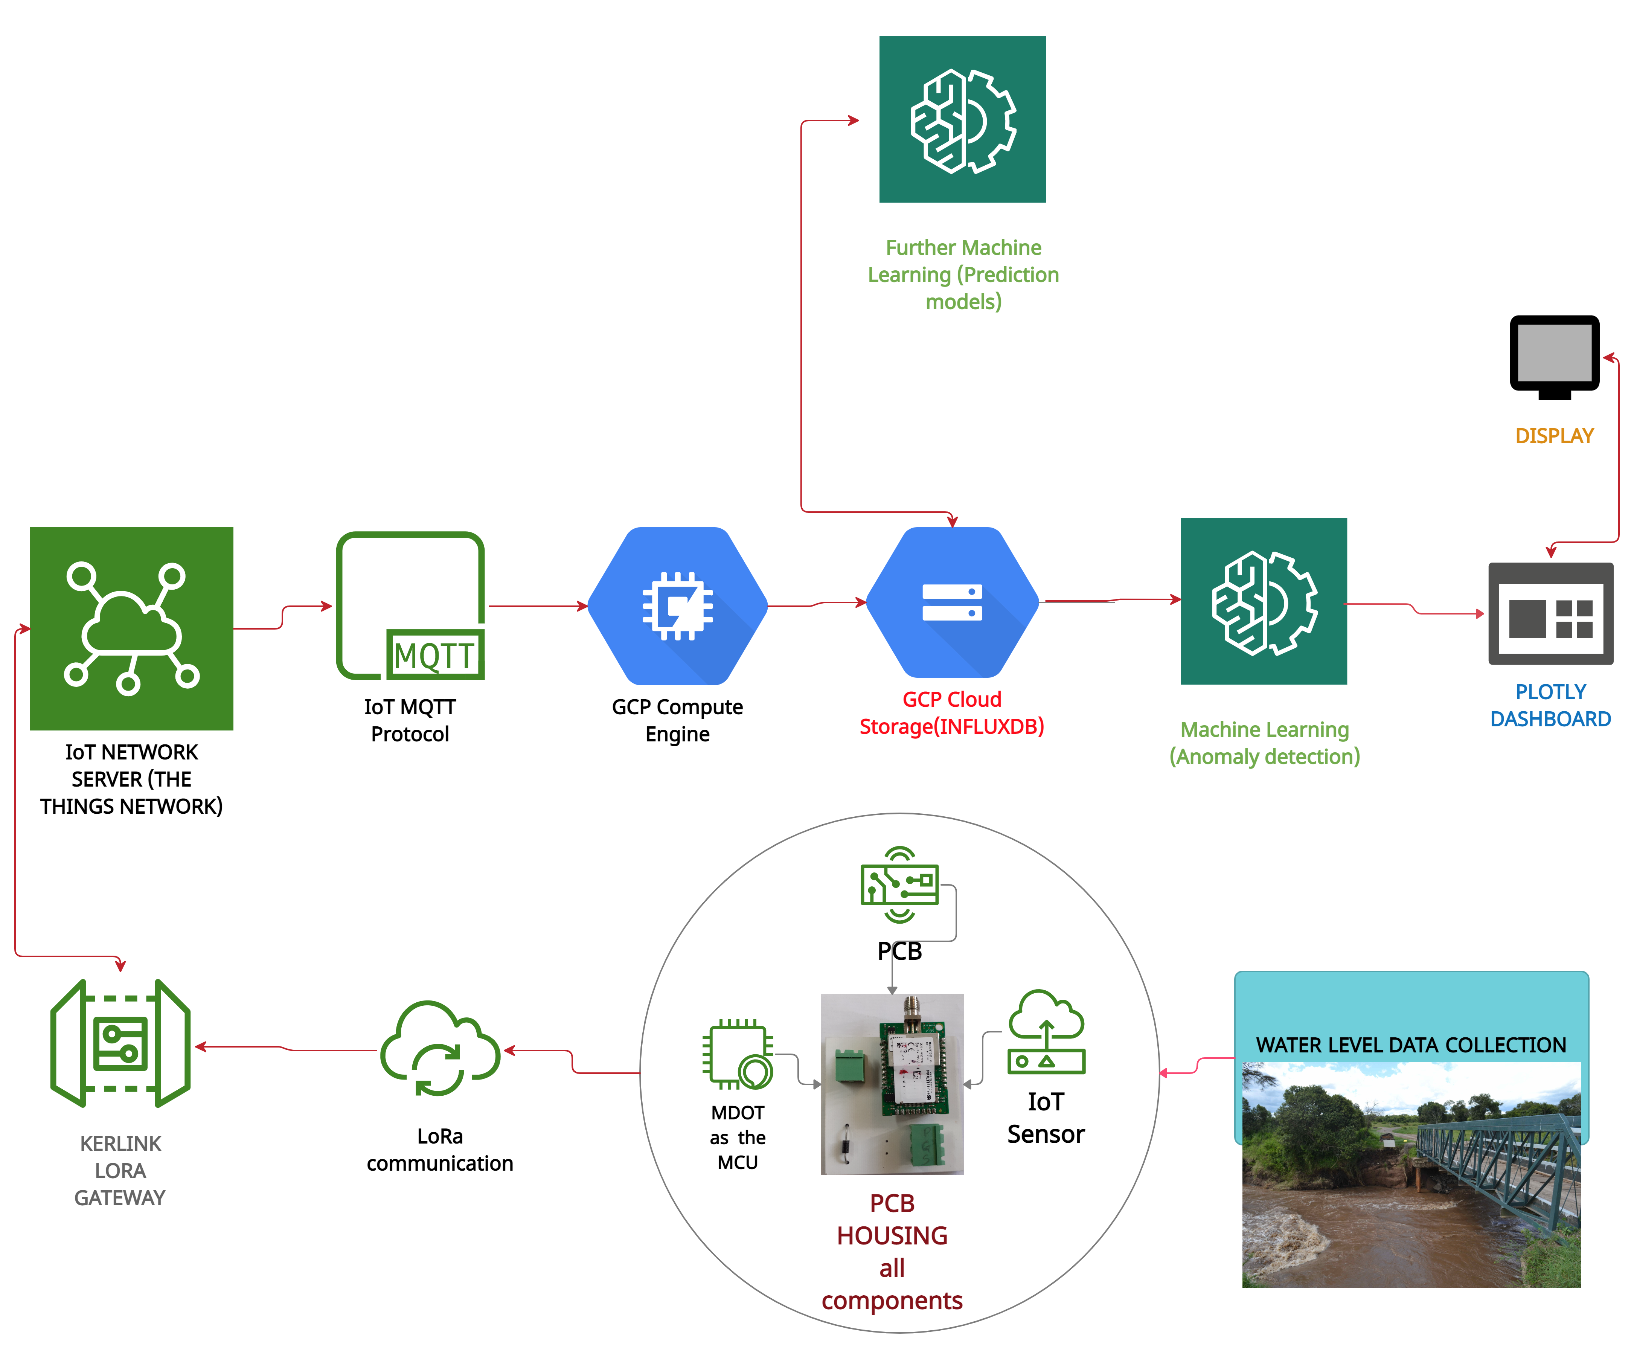
Hardware setup (Flow Chart)

Slide 8
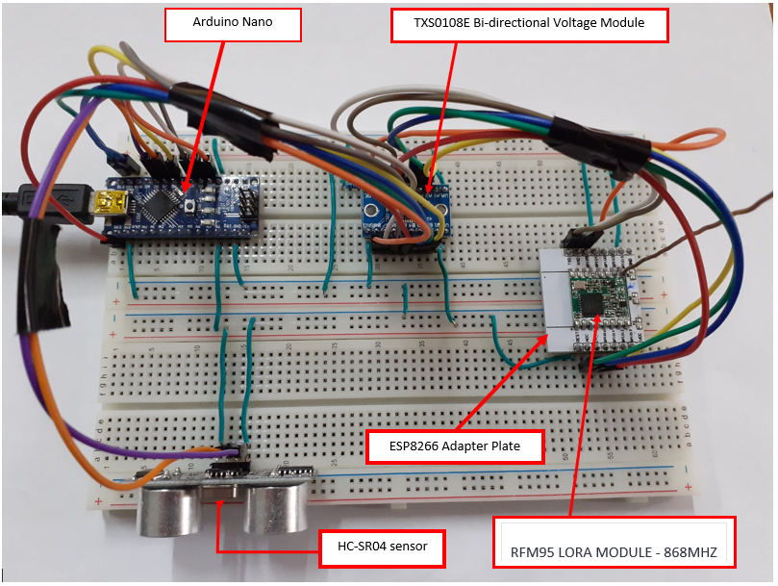
Hardware setup
Key Takeaways
Developed prototype
Setting up the LoRa Network – to handle data transmission.
Network analysis – to determine the radius of deployment .
Development of the actual water level monitoring prototype – to collect the data.
Development of web infrastructure – to handle transmission and storage (time-series cloud database).
Deployment .

Slide 9
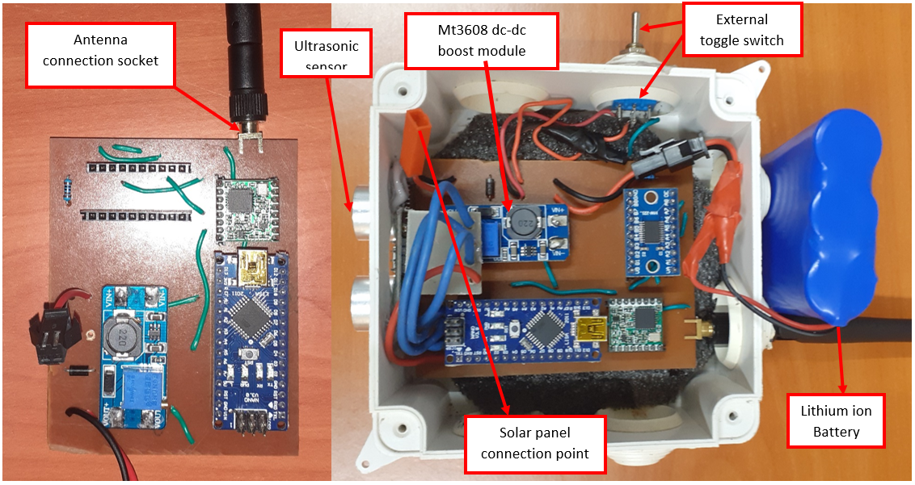
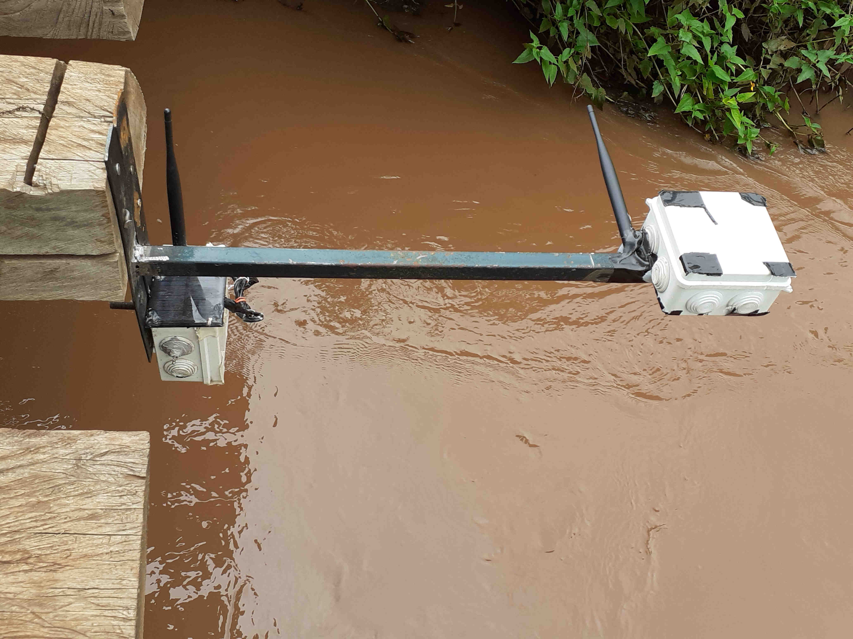
Hardware setup
Ready for deployment
Deployed prototype

Slide 10
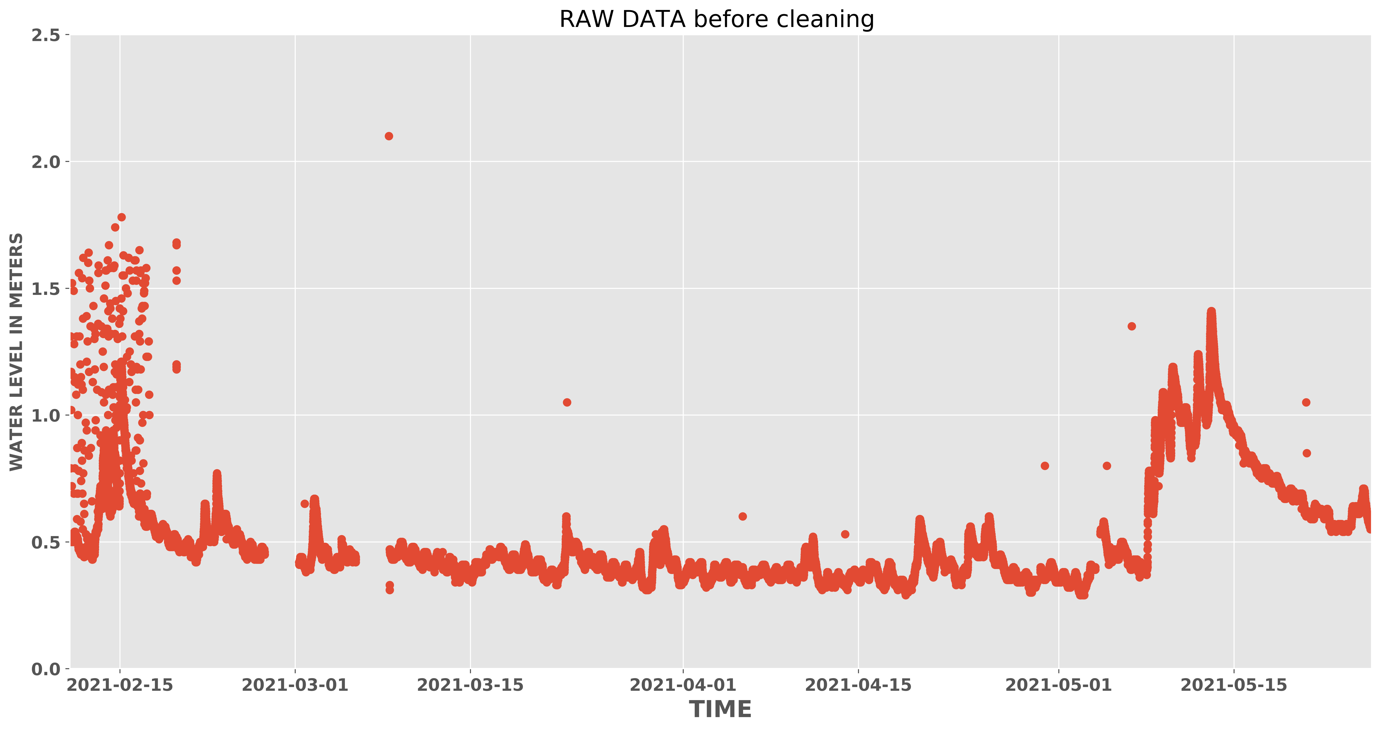
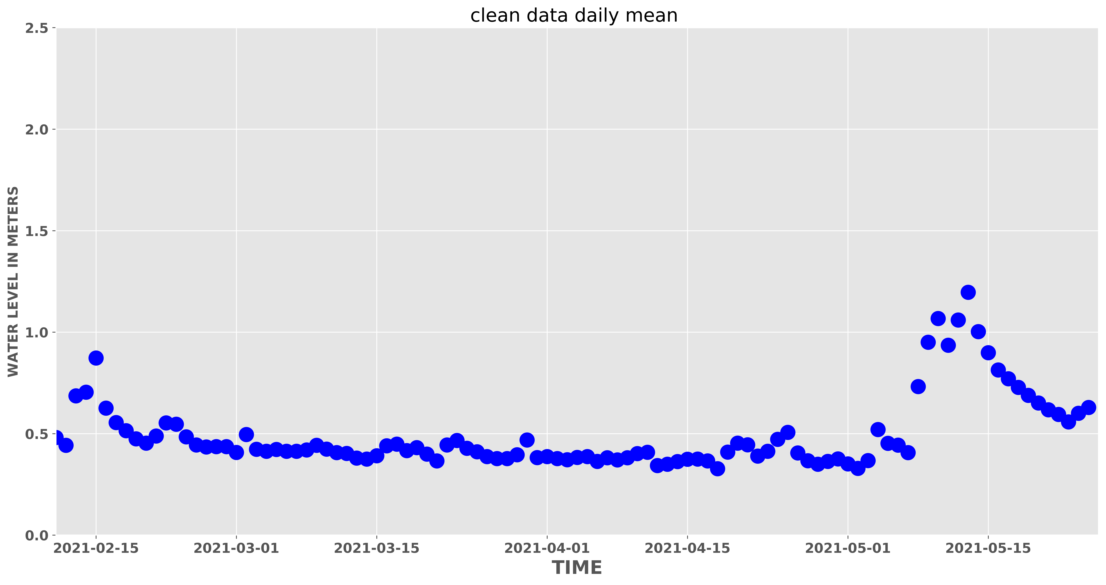
ANOMALY DETECTION (KMeans)
Raw data
Clean data (daily mean )

Slide 11
Links to this workshop
Links.
Kabi23.github.io
Dekut-dsail.github.io
https://github.com/DeKUT-DSAIL/arm-dev-summit

Slide 12
NAME
Jason N Kabi centre for Data Science and AI (DSAIL)
Dedan kimathi university of technology
EMAIL
Jason.kabi@dkut.ac.ke
Linkedin – Kabi Jason

